Slide 1



SRM INSTITUTE OF SCIENCE AND TECHNOLOGY
18CSC201J – Data Structures and Algorithms
Unit III- STACK & QUEUE

Slide 2
SESSION 2

Slide 3
Stack Implementation – Linked List

Slide 4
Pros Stack – Linked List
A stack data structure can be implemented by using a linked list
The stack implemented using linked list can work for the variable size of data. So, there is no need to fix the size at the beginning of the implementation

Slide 5
Stack – Linked list
Dynamic Memory allocation of Linked list is followed
The nodes are scattered and non-contiguously in the memory
Each node contains a pointer to its immediate successor node in the stack
Stack is said to be overflown if the space left in the memory heap is not enough to create a node

Slide 6
Stack – Linked list
In linked list implementation of a stack, every new element is inserted as 'top' element.
That means every newly inserted element is pointed by 'top'.
To remove an element from the stack, simply remove the node which is pointed by 'top' by moving 'top' to its previous node in the list.
The next field of the First element must be always NULL.

Slide 7
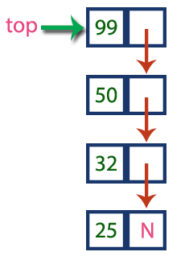
Example Stack – Linked List
Diagram Reference :http://www.btechsmartclass.com/data_structures/stack-using-linked-list.html

Slide 8
Create Node – Linked List
Include all the header files which are used in the program. And declare all the user defined functions
Define a 'Node' structure with two members data and next
Define a Node pointer 'top' and set it to NULL
Implement the main method by displaying Menu with list of operations and make suitable function calls in the main method

Slide 9
push(value) Inserting an element into the Stack
Create a newNode with given value
Check whether stack is Empty (top == NULL)
If it is Empty, then set newNode → next = NULL
If it is Not Empty, then set newNode → next = top
Finally, set top = newNode

Slide 10
pop() Deleting an Element from a Stack
Check whether stack is Empty (top == NULL)
If it is Empty, then display "Stack is Empty!!! Deletion is not possible!!!" and terminate the function
If it is Not Empty, then define a Node pointer 'temp' and set it to 'top‘
Then set 'top = top → next‘
Finally, delete 'temp'. (free(temp))

Slide 11
display() Displaying stack of elements
Check whether stack is Empty (top == NULL)
If it is Empty, then display 'Stack is Empty!!!' and terminate the function
If it is Not Empty, then define a Node pointer 'temp' and initialize with top
Display 'temp → data --->' and move it to the next node. Repeat the same until temp reaches to the first node in the stack. (temp → next != NULL)
Finally! Display 'temp → data ---> NULL'

Slide 12
Stack - Applications
Infix to Postfix Conversion
Postfix Evaluation
Balancing Symbols
Nested Functions
Tower of Hanoi

Slide 13
Infix to Postfix Conversion

Slide 14
Introduction
Expression conversion is the most important application of stacks
Given an infix expression can be converted to both prefix and postfix notations
Based on the Computer Architecture either Infix to Postfix or Infix to Prefix conversion is followed

Slide 15
What is Infix, Postfix & Prefix?
Infix Expression : The operator appears in-between every pair of operands. operand1 operator operand2 (a+b)
Postfix expression: The operator appears in the expression after the operands. operand1 operand2 operator (ab+)
Prefix expression: The operator appears in the expression before the operands. operator operand1 operand2 (+ab)

Slide 16
Example – Infix, Prefix & Postfix
Infix | Prefix | Postfix
(A + B) / D | / + A B D | A B + D /
(A + B) / (D + E) | / + A B + D E | A B + D E + /
(A - B / C + E)/(A + B) | / + - A / B C E + A B | A B C / - E + A B + /
B ^ 2 - 4 * A * C | - ^ B 2 * * 4 A C | B 2 ^ 4 A * C * -

Slide 17
Why postfix representation of the expression?
Infix expressions are readable and solvable by humans because of easily distinguishable order of operators, but compiler doesn't have integrated order of operators.
The compiler scans the expression either from left to right or from right to left.

Slide 18
Why postfix representation of the expression?
Consider the below expression: a op1 b op2 c op3 d If op1 = +, op2 = *, op3 = +
a + b *c +d
The compiler first scans the expression to evaluate the expression b * c, then again scan the expression to add a to it. The result is then added to d after another scan.

Slide 19
Why postfix representation of the expression?
The repeated scanning makes it very in-efficient. It is better to convert the expression to postfix(or prefix) form before evaluation.
The corresponding expression in postfix form is: abc*+d+.
The postfix expressions can be evaluated easily in a single scan using a stack.

Slide 20
ALGORITHM
Step 1 : Scan the Infix Expression from left to right.
Step 2 : If the scanned character is an operand, append it with final Infix to Postfix string.
Step 3 : Else,
Step 3.1 : If the precedence order of the scanned(incoming) operator is greater than the precedence order of the operator in the stack (or the stack is empty or the stack contains a ‘(’ ), push it on stack.
Step 3.2 : Else, Pop all the operators from the stack which are greater than or equal to in precedence than that of the scanned operator. After doing that Push the scanned operator to the stack. (If you encounter parenthesis while popping then stop there and push the scanned operator in the stack.)
Step 4 : If the scanned character is an ‘(‘ , push it to the stack.
Step 5 : If the scanned character is an ‘)’, pop the stack and and output it until a ‘(‘ is encountered, and discard both the parenthesis.
Step 6 : Repeat steps 2-6 until infix expression is scanned.
Step 7 : Print the output
Step 8 : Pop and output from the stack until it is not empty.

Slide 21
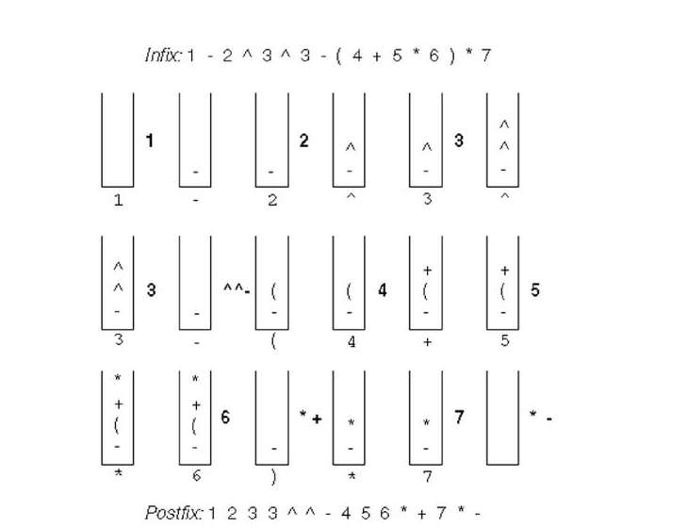
Example
Image from Data Structures by Mark Allen Weiss book

Slide 22
Exercise Problems to Solve Infix to Postfix conversion
A+B-C
A+B*C
(A+B)*C
(A+B)*(C-D)
((A+B)*C-(D-E))%(F+G)
A*(B+C/D)
((A*B)+(C/D))
((A*(B+C))/D)
(A*(B+(C/D)))
(2+((3+4)*(5*6)))
B ^ 2 - 4 * A * C
(A - B / C + E)/(A + B)

